Slide 1

William Stallings Computer Organization and Architecture 8th Edition
Chapter 12
Processor Structure and Function

Slide 2
Register organization
User visible
Control/status register
Instruction cycle
Pipelining

Slide 3
CPU Structure
CPU must:
Fetch instructions
Interpret instructions
Fetch data
Process data
Write data
Notes:
22

Slide 4
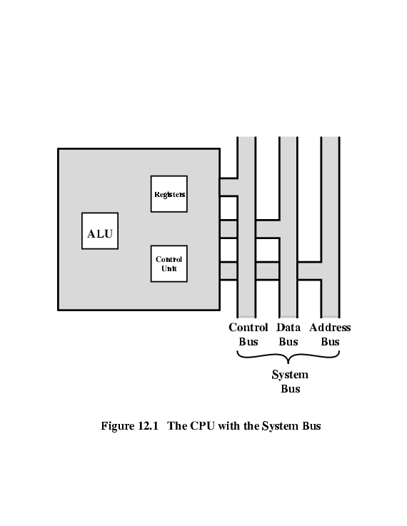
CPU With Systems Bus

Slide 5
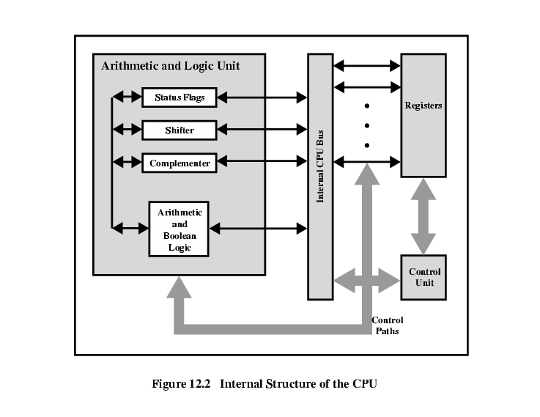
CPU Internal Structure

Slide 6
Registers
CPU harus mempunyai tempat sementara penyimpanan data
Called registers
Jumlah dan fungsi beragam tergantung desain processor
Top level of memory hierarchy
Jenis:
User visible
Control/status register
Notes:
23

Slide 7
User Visible Registers
Terdiri dari :
General Purpose
Data
Address
Condition Codes
Notes:
24

Slide 8
General Purpose Registers (1)
May be true general purpose
May be restricted (contoh untuk floating point)
Bisa digunakan untuk data maupun address
Notes:
25

Slide 9
General Purpose Registers (2)
Make them general purpose
Increase flexibility and programmer options
Increase instruction size & complexity
Make them specialized
Smaller (faster) instructions
Less flexibility
Notes:
26

Slide 10
How Many GP Registers?
Between 8 - 32
Fewer = more memory references
More does not reduce memory references and takes up processor real estate
Notes:
27

Slide 11
How big?
Large enough to hold full address
Large enough to hold full word
Often possible to combine two data registers
C programming
double int a;
Long int a;
Notes:
28

Slide 12
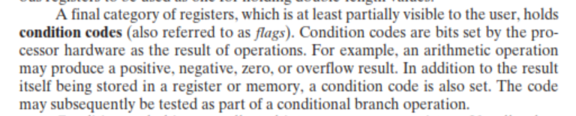
Condition Code Registers
Sets of individual bits
e.g. result of last operation was zero
Can be read (implicitly) by programs
e.g. Jump if zero
Can not (usually) be set by programs
Notes:
29

Slide 13
Control & Status Registers
Program Counter
Instruction Decoding Register
Memory Address Register
Memory Buffer Register
Revision: what do these all do?
Notes:
30

Slide 14
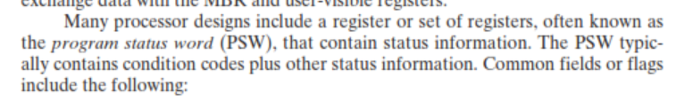
Program Status Word
A set of bits
Includes Condition Codes
Sign of last result
Zero
Carry
Equal
Overflow
Interrupt enable/disable
Supervisor
Notes:
31

Slide 15
Supervisor Mode
Intel ring zero
Kernel mode
Allows privileged instructions to execute
Used by operating system
Not available to user programs
Notes:
32

Slide 16
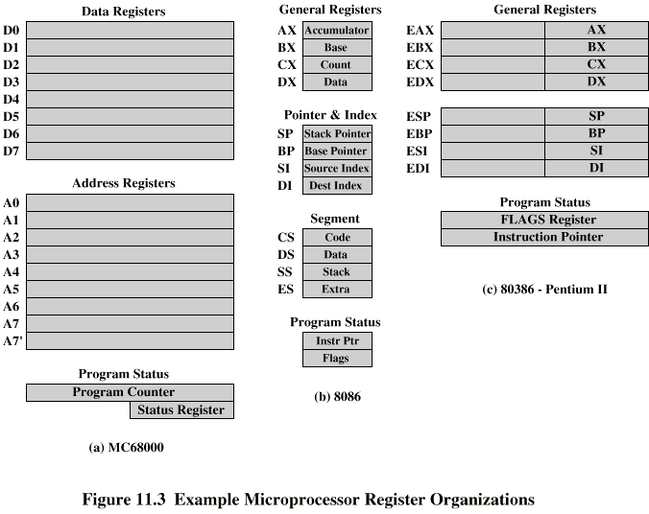
Example Register Organizations

Slide 17
Instruction Cycle
Revision
Stallings Chapter 3
Notes:
35

Slide 18
Indirect Cycle
May require memory access to fetch operands
Indirect addressing requires more memory accesses
Can be thought of as additional instruction subcycle

Slide 19
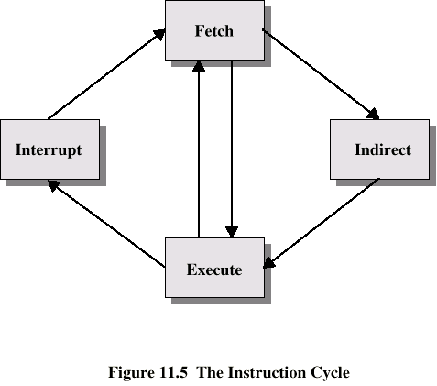
Instruction Cycle with Indirect

Slide 20
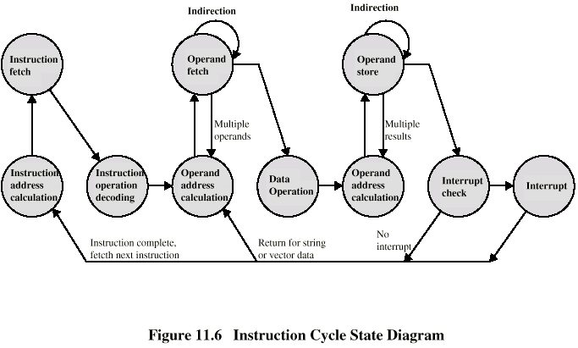
Instruction Cycle State Diagram

Slide 21
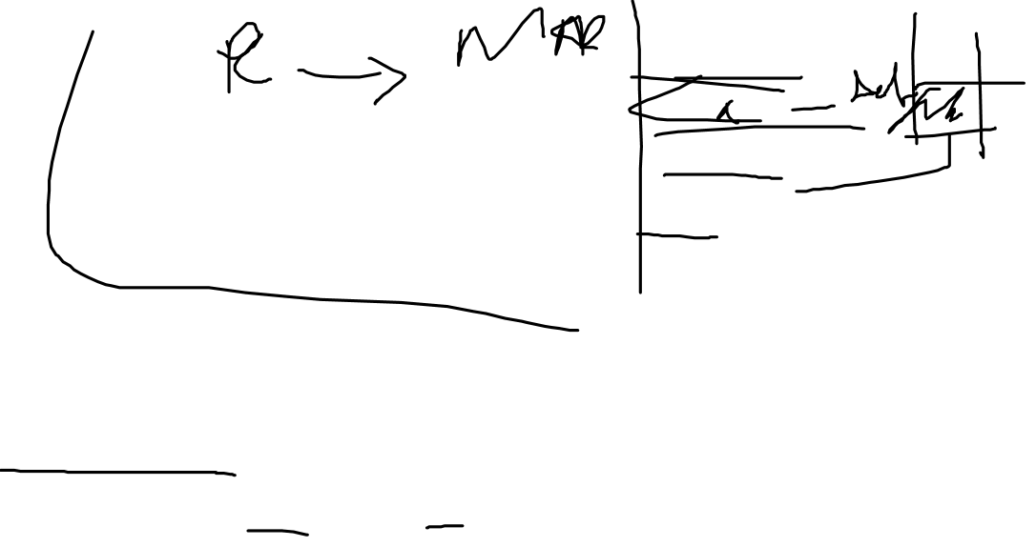
Data Flow (Instruction Fetch)
Depends on CPU design
In general:
Fetch
PC contains address of next instruction
Address moved to MAR
Address placed on address bus
Control unit requests memory read
Result placed on data bus, copied to MBR, then to IR
Meanwhile PC incremented by 1

Slide 22

Data Flow (Data Fetch)
IR is examined
If indirect addressing, indirect cycle is performed
Right most N bits of MBR transferred to MAR
Control unit requests memory read
Result (address of operand) moved to MBR

Slide 23
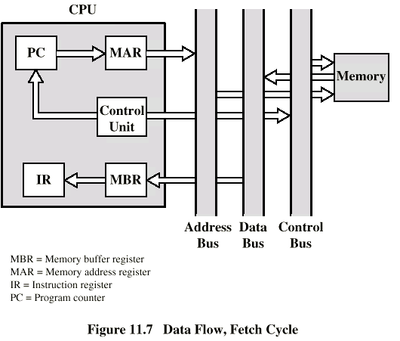

Data Flow (Fetch Diagram)

Slide 24
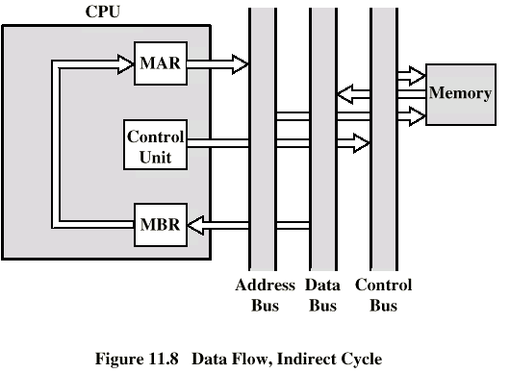

Data Flow (Indirect Diagram)

Slide 25

Data Flow (Execute)
May take many forms
Depends on instruction being executed
May include
Memory read/write
Input/Output
Register transfers
ALU operations

Slide 26

Data Flow (Interrupt)
Simple
Predictable
Current PC saved to allow resumption after interrupt
Contents of PC copied to MBR
Special memory location (e.g. stack pointer) loaded to MAR
MBR written to memory
PC loaded with address of interrupt handling routine
Next instruction (first of interrupt handler) can be fetched

Slide 27
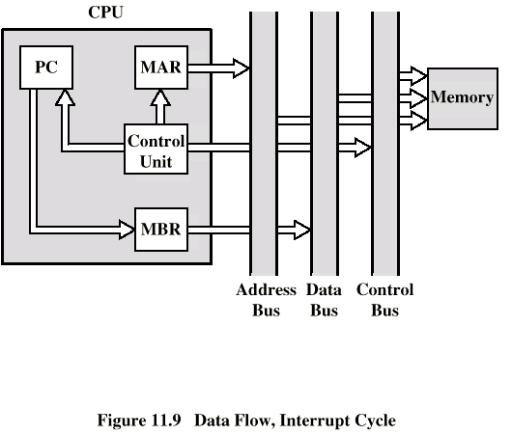
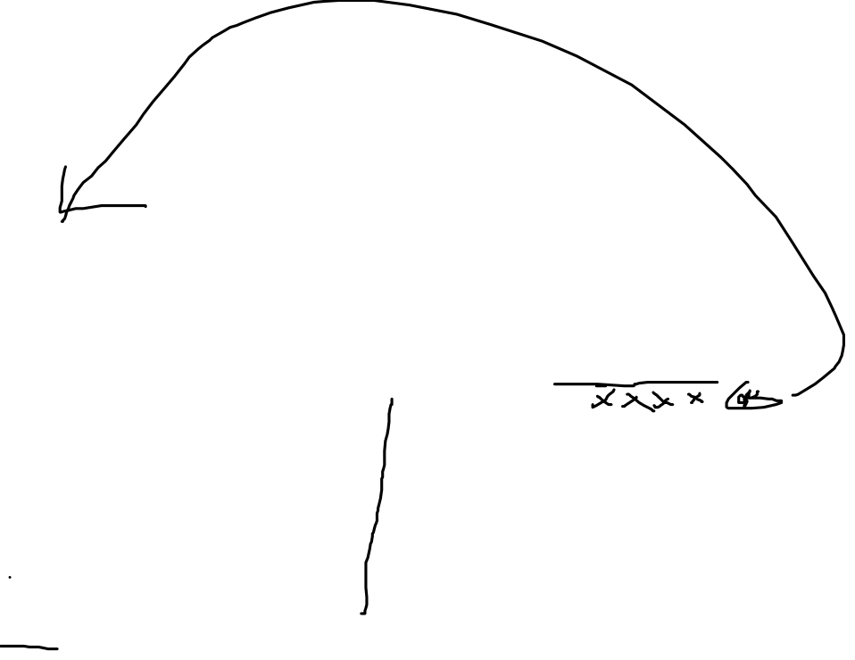
Data Flow (Interrupt Diagram)

Slide 28

Prefetch
Fetch accessing main memory
Execution usually does not access main memory
Can fetch next instruction during execution of current instruction
Called instruction prefetch
Notes:
36

Slide 29
Improved Performance
But not doubled:
Fetch usually shorter than execution
Prefetch more than one instruction?
Any jump or branch means that prefetched instructions are not the required instructions
Add more stages to improve performance
Notes:
37

Slide 30

Pipelining
Fetch instruction
Decode instruction
Calculate operands (i.e. EAs)
Fetch operands
Execute instructions
Write result
Overlap these operations
Notes:
38

Slide 31
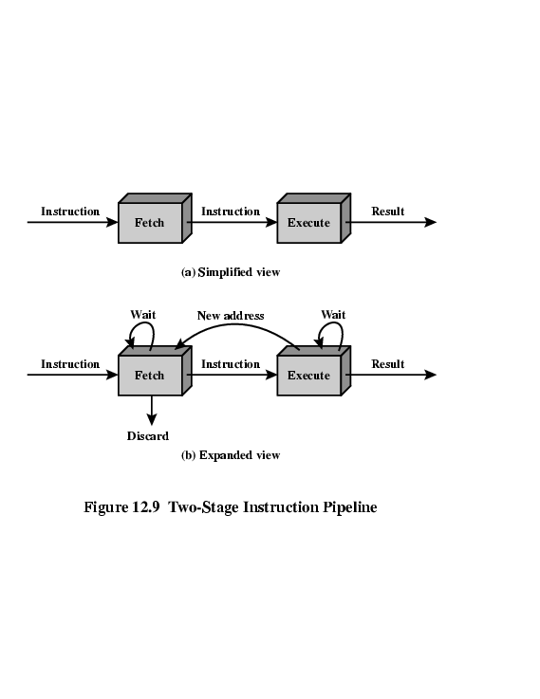

Two Stage Instruction Pipeline

Slide 32
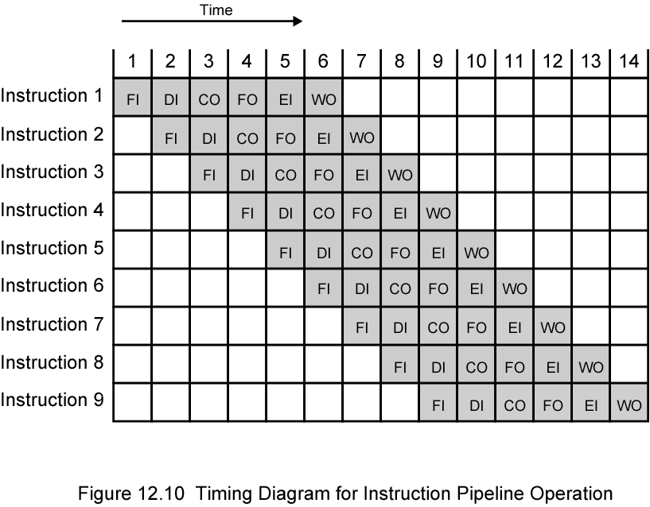

Timing Diagram for Instruction Pipeline Operation
Notes:
39

